Slide 1

Ahsanullah University of Science & Technology
IPE 4111: Industrial Management

Slide 2


Ahsanullah University of Science & Technology
IPE 4111: Industrial Management
What is Inventory??
Inventory is stock or store of goods
3 types of Inventory
Raw material
Work-in-process
Finished goods
MROs (Maintenance, Repair, and Operating Materials)
2

Slide 3
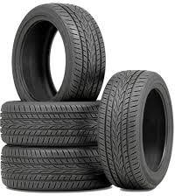
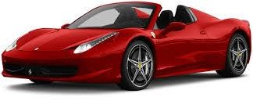
Ahsanullah University of Science & Technology
IPE 4111: Industrial Management
Independent demand - the demand for item is independent of the demand for any other item in inventory
Dependent demand - the demand for item is dependent upon the demand for some other item in the inventory
Dependent demand
Independent demand
3

Slide 4
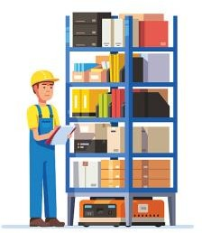
Ahsanullah University of Science & Technology
IPE 4111: Industrial Management
To meet anticipated demand
To smooth production requirements – seasonal
To protect against stock outs
To take advantages of quantity discounts
4

Slide 5


Ahsanullah University of Science & Technology
IPE 4111: Industrial Management
Inadequate control of inventories can result in both under and overstocking of items
The overall objective of inventory management is to achieve satisfactory levels of customer service while keeping inventory costs within reasonable bounds.
The timing
Size of orders
5

Slide 6


Ahsanullah University of Science & Technology
IPE 4111: Industrial Management
Holding (carrying) cost
Cost to carry an item in inventory for a length of time.
Ordering costs
Costs of ordering and receiving inventory.
Setup costs
The costs involved in preparing equipment for a job.
Shortage costs
Costs resulting when demand exceeds the supply of inventory; often unrealized profit per unit.
**Lead time: Time interval between ordering and receiving the order.
8

Slide 7
Ahsanullah University of Science & Technology
IPE 4111: Industrial Management
ABC Analysis
Classifies inventory items according to some measure of importance and then allocates control efforts accordingly.
The origin of ABC analysis is “The Pareto Principle” which is named after an Italian economist Vilfredo Pareto, also called as 80/20 rule. This principle suggests that 80% of the total output is generated only by 20% of the valuable efforts.
9

Slide 8

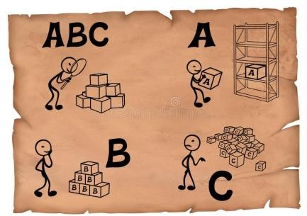
Ahsanullah University of Science & Technology
IPE 4111: Industrial Management
Typically, three classes of items:
A (very important)
B (moderately important)
C (least important)

Slide 9

Ahsanullah University of Science & Technology
IPE 4111: Industrial Management
A | Class A: 10-15% contribute
 | B | Class B: 20-30% cont
 |  | C | Class C: 6
s 60-70% value
ributes 20-30% value
0-70% contributes 5-10% value
Quantity
Cost
11

Slide 10
Ahsanullah University of Science & Technology
IPE 4111: Industrial Management
A manager has obtained a list of unit costs and estimated annual demands for 10 inventory items and now wants to categorize the items on an A-B-C basis.
Items
Annual Demand
Cost per unit(£)
Boxes of Paperclip
21,000
0.50
Boxes of staples
10,000
0.50
Correcting fluid
16,000
1.50
Diaries
50,000
3.50
Erasers
15,000
0.10
Notepads
40,000
2.0
Pencils
80,000
0.03
Pens
1,20,000
0.05
Rulers
15,000
0.25
Staplers
10,000
1.50
12

Slide 11
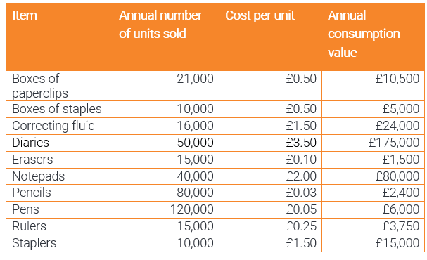
Ahsanullah University of Science & Technology
IPE 4111: Industrial Management
13

Slide 12
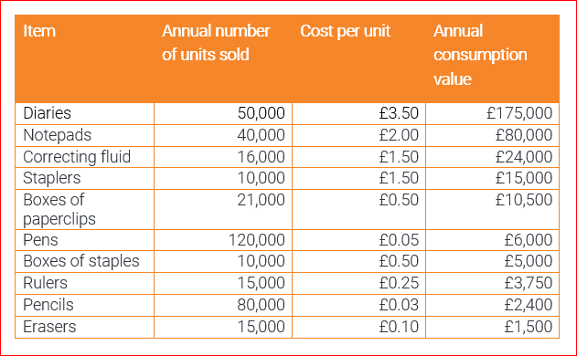
Ahsanullah University of Science & Technology
IPE 4111: Industrial Management
14

Slide 13
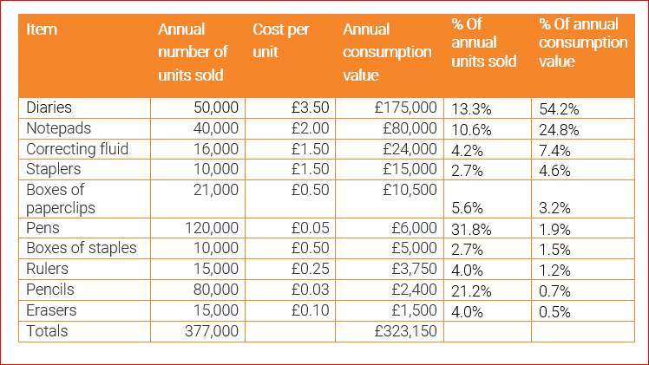
Ahsanullah University of Science & Technology
IPE 4111: Industrial Management
15

Slide 14
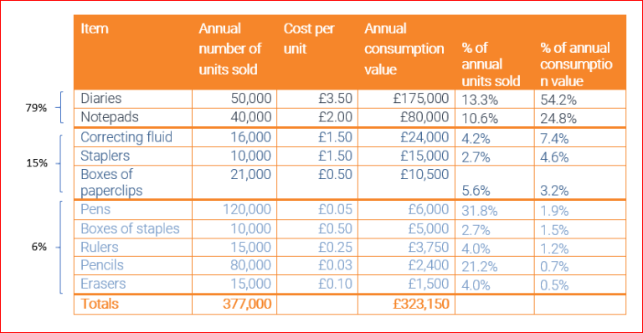
Ahsanullah University of Science & Technology
IPE 4111: Industrial Management
16

Slide 15
Ahsanullah University of Science & Technology
IPE 4111: Industrial Management
Cost
Class A
80
Class B
Class C
23% 13%
64% Quantity
17

Slide 16
Ahsanullah University of Science & Technology
IPE 4111: Industrial Management
Need to determine when and how much to order
The basic economic order quantity model
The economic production quantity model
The quantity discount model
18

Slide 17
Ahsanullah University of Science & Technology
IPE 4111: Industrial Management
Maximum
inventory
Usage rate
Quantity
level
ROP
Place
^{order} Receive
order
Minimum inventory level
LT
Time
19

Slide 18

Ahsanullah University of Science & Technology
IPE 4111: Industrial Management
EOQ is the order quantity that minimizes total cost
Assumptions
Only one product is involved
Annual demand requirements are known
Demand is spread evenly
Lead time does not vary
No quantity discount
20

Slide 19

Ahsanullah University of Science & Technology
IPE 4111: Industrial Management
𝑄
Average inventory level × Holding cost per unit per year
Annual Holding Cost, HC = 𝐻
2
𝐷
Annual Ordering Cost, OC = 𝑆
Number of orders placed annually ×
Order cost per order
𝑄
𝑄 𝐷
Total Cost, TC = 𝐻 + 𝑆
2 𝑄
Material Cost
𝑄
𝐷
Total Cost (including Material), TC = 𝐻 + 𝑆 +
𝐷 × 𝑃
2 𝑄
2𝐷𝑆
𝑓𝑜𝑟 𝑀𝑖𝑛𝑖𝑚𝑢𝑚 𝐶𝑜𝑠𝑡, 𝑄 =
𝐻
21

Slide 20

Ahsanullah University of Science & Technology
Annual
Cost
Total Cost
Holding Cost
Material Cost
Ordering Cost
EOQ
Order Quantity
24

Slide 21

Ahsanullah University of Science & Technology
IPE 4111: Industrial Management
(LT = 0)
A local distributor for a national tire company expects to sell approximately 9,600 steel-belted radial tires of a certain size and tread design next year. Annual carrying cost is $16 per tire, and ordering cost is $75. The distributor operates 288 days a year.
a. Determine the optimal number of tires to order.
25

Slide 22
Ahsanullah University of Science & Technology
IPE 4111: Industrial Management
(LT = 0)
A local distributor for a national tire company expects to sell approximately 9,600 steel-belted radial tires of a certain size and tread design next year. Annual carrying cost is $16 per tire, and ordering cost is $75. The distributor operates 288 days a year.
a. Determine the optimal number of tires to order.
2𝐷𝑆
𝐻
2 × 9600 ×75
𝑊𝑒 𝑘𝑛𝑜𝑤, 𝑄 =
=
= 300 tires per order
16
25

Slide 23

Ahsanullah University of Science & Technology
IPE 4111: Industrial Management
A local distributor for a national tire company expects to sell approximately 9,600 steel-belted radial tires of a certain size and tread design next year. Annual carrying cost is $16 per tire, and ordering cost is $75. The distributor operates 288 days a year.
b. How many times per year does the store reorder?
26

Slide 24
Ahsanullah University of Science & Technology
IPE 4111: Industrial Management
A local distributor for a national tire company expects to sell approximately 9,600 steel-belted radial tires of a certain size and tread design next year. Annual carrying cost is $16 per tire, and ordering cost is $75. The distributor operates 288 days a year.
b. How many times per year does the store reorder?
We know,
Number of orders per year, N = =
𝐷 9600 𝑡𝑖𝑟𝑒𝑠/𝑦𝑟
𝑄 300 𝑡𝑖𝑟𝑒𝑠/𝑜𝑟𝑑𝑒𝑟
= 32 orders per year
26

Slide 25
Ahsanullah University of Science & Technology
IPE 4111: Industrial Management
A local distributor for a national tire company expects to sell approximately 9,600 steel-belted radial tires of a certain size and tread design next year. Annual carrying cost is $16 per tire, and ordering cost is $75. The distributor operates 288 days a year.
c. Determine the length of an order cycle or expected time between orders.
27

Slide 26
Ahsanullah University of Science & Technology
IPE 4111: Industrial Management
A local distributor for a national tire company expects to sell approximately 9,600 steel-belted radial tires of a certain size and tread design next year. Annual carrying cost is $16 per tire, and ordering cost is $75. The distributor operates 288 days a year.
c. Determine the length of an order cycle or expected time between orders.
𝑁𝑢𝑚𝑏𝑒𝑟 𝑜𝑓 𝑤𝑜𝑟𝑘𝑖𝑛𝑔 𝑑𝑎𝑦𝑠 𝑝𝑒𝑟 𝑦𝑒𝑎𝑟
Length of an order cycle =
𝑁𝑢𝑚𝑏𝑒𝑟 𝑜𝑓 𝑜𝑟𝑑𝑒𝑟𝑠 𝑝𝑒𝑟 𝑦𝑒𝑎𝑟, 𝑁
288
32
=
= 9 days
27

Slide 27
Ahsanullah University of Science & Technology
IPE 4111: Industrial Management
A local distributor for a national tire company expects to sell approximately 9,600 steel-belted radial tires of a certain size and tread design next year. Annual carrying cost is $16 per tire, and ordering cost is $75. The distributor operates 288 days a year.
d. Determine the annual Total cost.
8

Slide 28
Ahsanullah University of Science & Technology
IPE 4111: Industrial Management
A local distributor for a national tire company expects to sell approximately 9,600 steel-belted radial tires of a certain size and tread design next year. Annual carrying cost is $16 per tire, and ordering cost is $75. The distributor operates 288 days a year.
d. Determine the annual Total cost.
We know,
𝑄 𝐷
Total Cost, TC = 𝐻 +
Q
300
× 16 +
9600
× 75
𝑆
=
2
2 300
=2400 + 2400 = $4800
8

Slide 29
Ahsanullah University of Science & Technology
IPE 4111: Industrial Management
(LT = 0)
Piddling Manufacturing assembles security monitors. It purchases 3,600 black-and-white cathode ray tubes a year at $65 each. Ordering costs are $31, and annual carrying costs are 20 percent of the purchase price.
a. Compute the optimal quantity and the total annual cost of ordering and carrying the inventory.
29

Slide 30
Ahsanullah University of Science & Technology
IPE 4111: Industrial Management
(LT = 0)
Piddling Manufacturing assembles security monitors. It purchases 3,600 black-and-white cathode ray tubes a year at $65 each. Ordering costs are $31, and annual carrying costs are 20 percent of the purchase price.
a. Compute the optimal quantity and the total annual cost of ordering and carrying the inventory.
2𝐷𝑆 2 × 3600 × 31 2 × 3600 × 31
𝐻
𝑊𝑒 𝑘𝑛𝑜𝑤, 𝑄 =
= =
65 × 0.2 13
≈ 131 cathode ray tubes
29

Slide 31
Ahsanullah University of Science & Technology
IPE 4111: Industrial Management
Piddling Manufacturing assembles security monitors. It purchases 3,600 black-and-white cathode ray tubes a year at $65 each. Ordering costs are $31, and annual carrying costs are 20 percent of the purchase price.
a. Compute the optimal quantity and the total annual cost of ordering and carrying the inventory.
30

Slide 32
Ahsanullah University of Science & Technology
IPE 4111: Industrial Management
Piddling Manufacturing assembles security monitors. It purchases 3,600 black-and-white cathode ray tubes a year at $65 each. Ordering costs are $31, and annual carrying costs are 20 percent of the purchase price.
a. Compute the optimal quantity and the total annual cost of ordering and carrying the inventory.
We know,
𝑄 𝐷
Total Cost, TC = 𝐻 + 𝑆
131
× 13 +
3600
× 31
=
2 𝑄
2
131
≈ 852 + 852
= $1704
30

Slide 33

Ahsanullah University of Science & Technology
IPE 4111: Industrial Management
A large bakery buys flour in 25-pound bags. The bakery uses an average of 1,215 bags a year. Preparing an order and receiving a shipment of flour involves a cost of $10 per order. Annual carrying costs are $75 per bag.
Determine the economic order quantity.
How many orders per year will there be?
Compute the total cost of ordering and carrying flour.
If holding costs were to increase by $9 per year, how much would that
affect the minimum total annual cost?
31

Slide 34


Ahsanullah University of Science & Technology
IPE 4111: Industrial Management
a. Economic Order Quantity:
2𝐷𝑆 2 × 1215 × 10
𝐻 75
𝑊𝑒 𝑘𝑛𝑜𝑤, 𝑄 =
=
= 18 bags per order
32

Slide 35

Ahsanullah University of Science & Technology
IPE 4111: Industrial Management
b. Number of orders per year:
𝐷 1215
= = 𝟔𝟕. 𝟓
𝑄 18
c. Total cost:
𝑄
𝐷
18
1215
TC = 𝐻 + 𝑆
= × 75
+ × 10
2 𝑄
2 18
= 675 + 675 = $1350
33

Slide 36
Ahsanullah University of Science & Technology
IPE 4111: Industrial Management
d. By increasing holding costs by $9 per year:
2𝐷𝑆 2 × 1215 × 10
𝐻 75 + 9
24300
𝑄 =
=
=
= 17 bags per order
84
𝑄 𝐷
17
1215
⸫ Total Cost, TC = 𝐻 + 𝑆
= × 84 + × 10
2 𝑄 2 17
= 714 + 715 = $1429
Thus, total annual cost increases by $79
34

Slide 37
Ahsanullah University of Science & Technology
IPE 4111: Industrial Management
If demand and lead time are both constant, the reorder point is easy to calculate.
𝑅𝑂𝑃 = 𝑑 × 𝐿𝑇
Where,
d = Demand rate (units per day or week) LT = Lead time in days or weeks

Slide 38
Ahsanullah University of Science & Technology
IPE 4111: Industrial Management
(LT ≠ 0)
Kevin takes Two-a-Day vitamins, which are delivered to his home by a routeman three days after an order is called in. At what point should Kevin reorder?
Usage rate = 2 vitamins per day
Lead time = 3 days
ROP = Usage rate × Lead time
= 2 vitamins per day × 3 days
= 6 vitamins
52

Slide 39

Ahsanullah University of Science & Technology
IPE 4111: Industrial Management
Stock that is held in excess of expected demand due to variable demand and/or lead time.
𝑅𝑂𝑃 = 𝑑 × 𝐿𝑇 + 𝑠𝑠
Where,
d = Demand rate (units per day or week)
LT = Lead time in days or weeks ss = Safety Stock

Slide 40
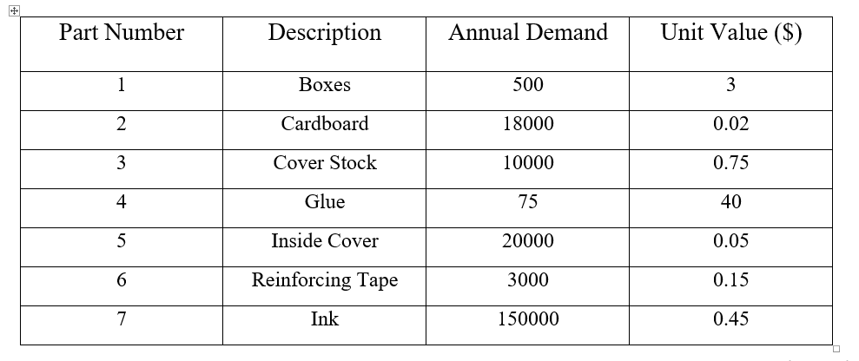
Ahsanullah University of Science & Technology
IPE 4111: Industrial Management
ABC Analysis Example
67

Slide 41

Ahsanullah University of Science & Technology
IPE 4111: Industrial Management
Reference: Operations Management (11th edition) By William Stevenson (Chapter 13)
67

